Slide 1
Healthify ER Diagrams – S2

Slide 2
Team 4 : Healthify List of Entities
Entity Name | Entity Primary Attributes
Subscription | subscriptionID (PK), userID (FK), subscriptionTypeID (FK), subscriptionAmount
SubscriptionTypes | subscriptionTypeID (PK), subscriptionType, subscriptionTypeDescription
Doctor | doctorID (PK), doctorName, doctorEmail, doctorPassword, doctorPhone
Guest | guestID (PK), guestName, guestEmail, guestPassword, guestPhone
User | userID (PK), username, userEmail, userPassword, userPhone, guestID, subscriptionID (FK)
Appointment | appointmentID (PK), userID (FK), scheduleID (FK), appointmentDate
Billing | billingID (PK), userID (FK), subscriptionID (FK), paymentAmount, paymentDate, paymentStatus
PaymentMethod | paymentMethodID (PK), userID (FK), paymentTypeID (FK), paymentMethodDetails, defaultPaymentMethod
PaymentType | paymentTypeID (PK), paymentTypeName, paymentTypeDescription
Advertising | advertisementID (PK), advertisementTitle, advertisementContent, advertisementStartDate, advertisementEndDate
Schedule | scheduleID(PK), doctorID(FK), scheduledate, numberOfPatients, scheduleTime
CustomerSupport | ticketID (PK), userID(FK), title, ticketDescription, priorityID (FK), statusID (FK), notes, staffName, ticketDate, resolutionDate
TicketStatus | statusID (PK), statusName, statusDescription
TicketPriority | priorityID (PK), priorityName, priorityDescription
GuestAdvertising | guestID (PK, FK), advertisementID (PK, FK)
UserAdvertising | userID (PK, FK), advertisementID (PK, FK)
DoctorAdvertising | doctorID (PK, FK), advertisementID (PK, FK)

Slide 3
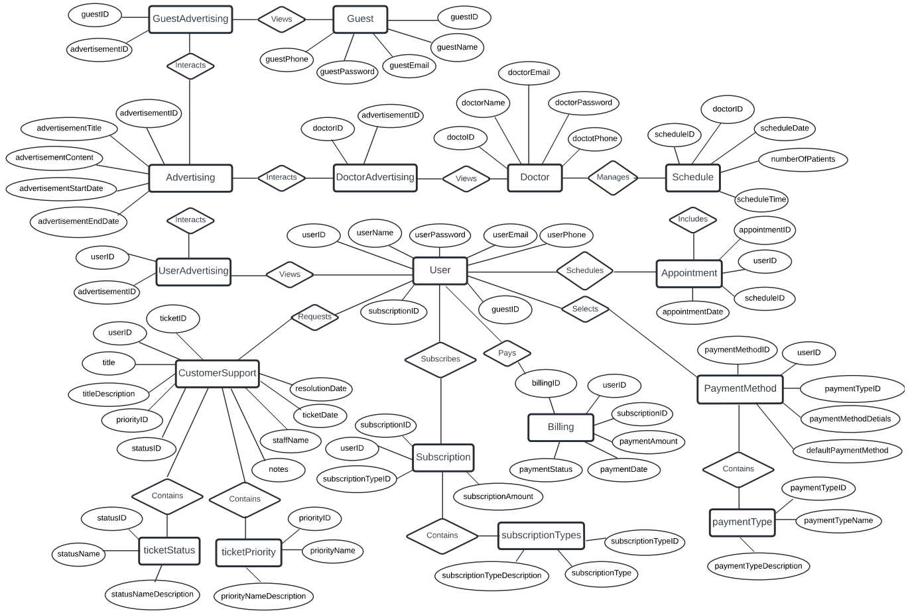
Team 4 : Healthify Conceptual ER Diagram

Slide 4
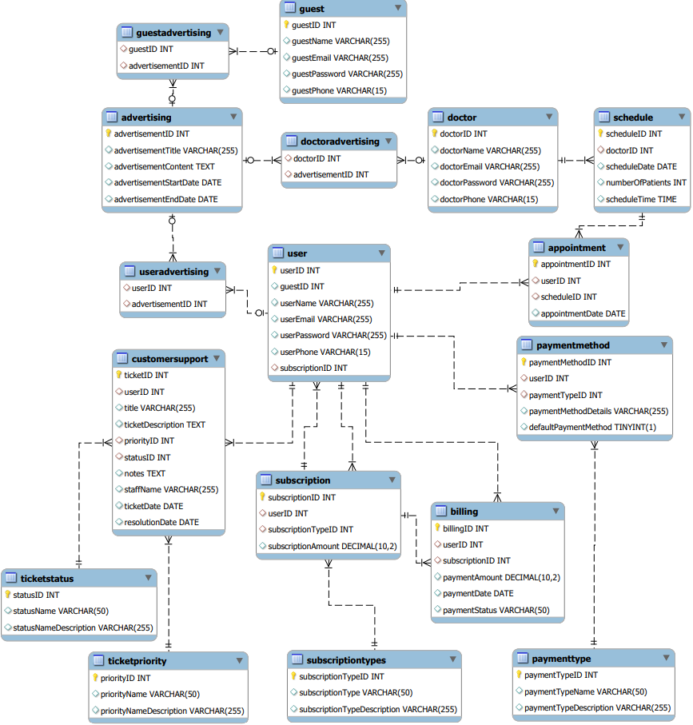
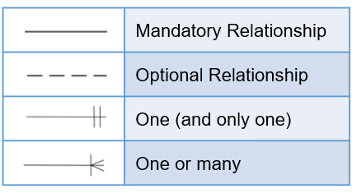
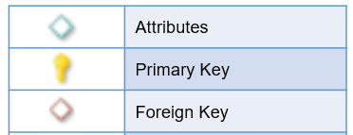
Team 4 : Healthify Logical ER Diagram
Software Used:
MySql (Database Reverse Engineer)

Slide 5
Healthify ER Diagrams – S3

Slide 6
Team 4 : Healthify List of Entities
Entity Name | Entity Primary Attributes
Doctor | doctorID (PK), doctorName, doctorEmail, doctorPassword, doctorPhone
Guest | guestID (PK), guestName, guestEmail, guestPassword, guestPhone
User | userID (PK), username, userEmail, userPassword, userPhone, guestID, subscriptionID (FK)
Billing | billingID (PK), userID (FK), subscriptionID (FK), paymentAmount, paymentDate, paymentStatus
Advertising | advertisementID (PK), advertisementTitle, advertisementContent, advertisementStartDate, advertisementEndDate
CustomerSupport | ticketID (PK), userID(FK), title, ticketDescription, priorityID (FK), statusID (FK), notes, staffName, ticketDate, resolutionDate
TicketStatus | statusID (PK), statusName, statusDescription
TicketPriority | priorityID (PK), priorityName, priorityDescription
GuestAdvertising | guestID (PK, FK), advertisementID (PK, FK)
UserAdvertising | userID (PK, FK), advertisementID (PK, FK)
DoctorAdvertising | doctorID (PK, FK), advertisementID (PK, FK)

Slide 7
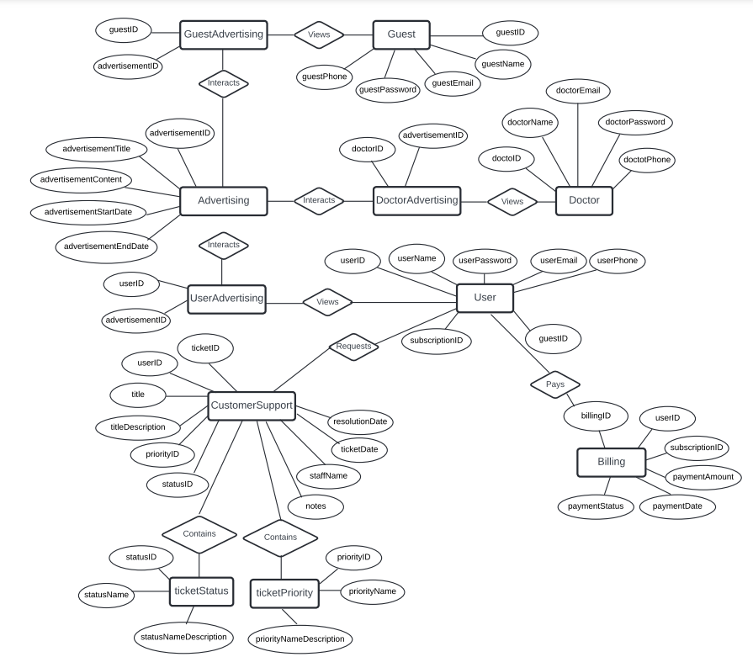
Team 4 : Healthify Conceptual ER Diagram

Slide 8
Team 4 : Healthify Logical ER Diagram
Software Used:
MySql (Database Reverse Engineer)

